Slide 1
Enhanced MOSFET Failure Strategy
Dennis Skellenger

Slide 2
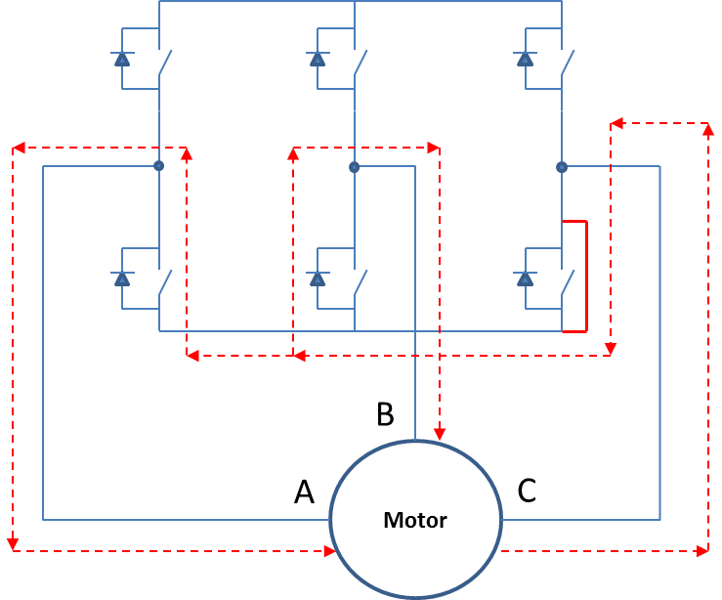
MOSFET Failure Background
When a MOSFET shorts, back EMF of the motor causes recirculation currents and will generate a braking torque that opposes motor and hand wheel movement. This torque generated is a function of motor size and velocity along with assist ratios.
The controller need not be powered or even plugged into vehicle power. The braking torque is the consequence of the short and the internal body diodes of the other MOSFET’s in the bridge that will conduct at a back EMF greater than the diode voltage.
For many systems, this failure mode may generate torques that violate the maximum steering effort requirement.

Slide 3
MOSFET Failure Upper vs Lower
When a MOSFET shorts, back EMF of the motor causes recirculation currents and will generate a braking torque. The controller need not be powered or even plugged into vehicle power. The braking torque is the consequence of the short and the internal body diodes of the other MOSFET’s in the bridge that will conduct at a back EMF greater than the diode voltage. If the impedance of the layout is similar for upper and lower MOSFET traces then the opposing torque is equal for an upper or lower short
Lower C MOSFET short
Upper C MOSFET short
A
Motor
C
B
B
A
Motor
C

Slide 4
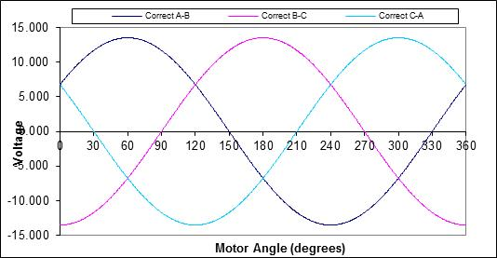
MOSFET Failure Upper vs Lower (Simplified Circuits)
Lower C MOSFET short
Upper C MOSFET short
A
Motor
C
A
Motor
C
B
B
Braking due to MOSFET short vs BackEMF
Dynamic Braking C Upper Short
Dynamic Braking C lower Short
Dynamic Braking C lower Short
Dynamic Braking
Dynamic Braking

Slide 5
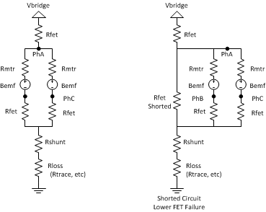
Detecting a Shorted MOSFET
The principal behind shorted MOSFET detection is that the MOSFET’s resistance is small compared to that of the motor. Therefore, the majority of the bridge voltage drop occurs across the motor with a much smaller voltage drop across the MOSFETs. During a shorted MOSFET failure, when the complementary MOSFET is turned on, the entire bridge voltage is split between the two MOSFETs. A shorted MOSFET is indicated when a MOSFETs “ON” voltage exceeds a threshold.
During a stall condition the motor’s BEMF is zero and a worst case maximum voltage level across the FET in normal operating mode can be determined.
During a MOSFET short the worst case minimum MOSFET voltage is determined.
If the maximum voltage during the normal operating mode is less than the worse case minimum during a MOSFET short than it can be compared against a threshold voltage to determine if a shoot through is occurring.

Slide 6
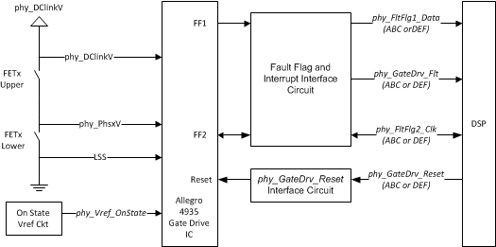
Detecting a Shorted MOSFET (continued)
The Allegro gate drives were specified to utilize a method of fault detection jointly developed by Nexteer several years ago.
The fault detection has the following requirements:
Detect shorted MOSFET
Shut down the bridge within microseconds to limit shoot through current
Report the fault to the DSP
Report MOSFET that Failed

Slide 7
Motor Torque with a MOSFET Short
During a MOSFET Short the complimentary FET cannot be commutated because this would only result in shoot through current to ground. This would be 100’s of amps.
The bridge is then disabled but voltage from the back EMF will conduct internal body diodes of the MOSFETs through the short and result in braking torque.
Simulations of the braking torque at various speeds (Subhra’s simulations)
Motor parameters for Simulations
Motor phase resistance 11.25 mΩ
Motor phase inductance 84.5 μH
Motor voltage constant 0.0374 V/rads-1
Controller resistance per phase 0.1 mΩ
FET on resistance 1 mΩ
Short resistance 1 mΩ

Slide 8
Motor Torque with a MOSFET Short (continued)
100 RPM
200 RPM
500 RPM
1000 RPM

Slide 9
Motor Torque with a MOSFET Short (continued)
1500 RPM
2000 RPM
3000 RPM
4000 RPM

Slide 10
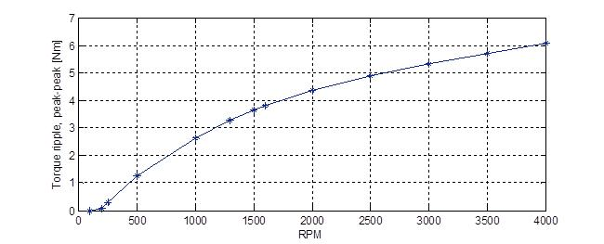
Pk to Pk Torque Ripple vs. RPM During Lower C FET short

Slide 11
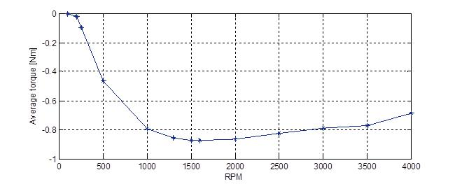
Average Torque Ripple vs RPM During Lower C FET short

Slide 12
Goals of MOSFET Failure Strategy
Provide assist to the driver with the faulted controller running in a “limp home” mode
Analyze the failure and determine MOSFET that failed
Alter commutation strategy to provide assist torque when possible without using the faulted phase
Reduce the effect of the braking torque to the driver.
Ripple of system must be minimized while maintaining positive assist
Highly vehicle/system dependent
Other Factors
Implement the strategy with minimal impact on software and hardware
No phase disconnects: relays unreliable, MOSFET’s expensive
Modify current commutation strategies
Inverter heat dissipation must not be significantly impacted which would require a new thermal duty algorithm or different calibrations to ensure thermal protection

Slide 13
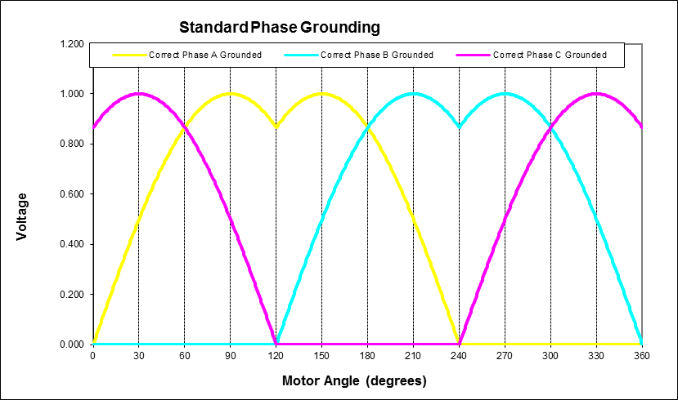
Normal Phase Voltage Waveforms: Line to Nuetral

Slide 14
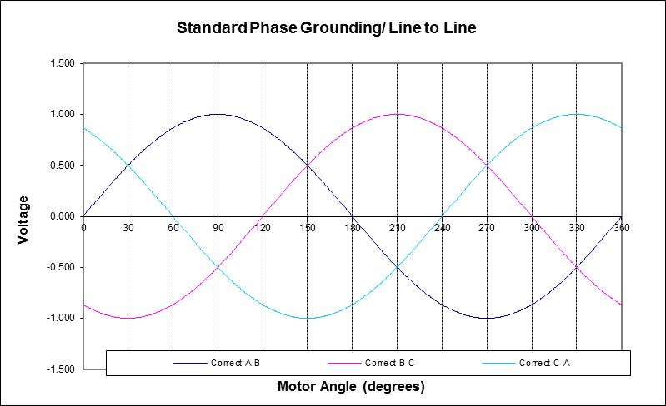
Normal Phase Voltage Waveforms: Line to Line

Slide 15
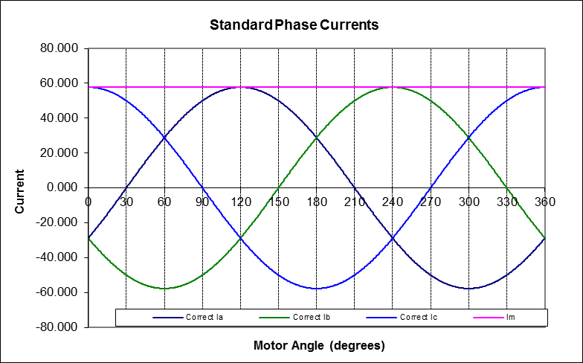
Normal Phase Current Waveforms

Slide 16
Standard MOSFET Short Failure Mitigation Strategy
This example analysis is for a Lower Phase C failure but can be used for all other single MOSFET failures
When Phase C lower MOSFET has a short, the Phase C upper MOSFET can no longer be turned on. This prevents the Vca line to line voltage from having a positive voltage and the Vbc line to line voltage from having a negative voltage. During those portions of the electrical cycle the MOSFETs for A & B are turned off to prevent additional current flow in the opposing torque direction making the situation worse.
During the portion of the electrical cycle where the Phase C lower MOSFET would normally be on, the MOSFETs for Phase A & B are turned on normally with a magnitude adjustment to provide increased assist torque.

Slide 17
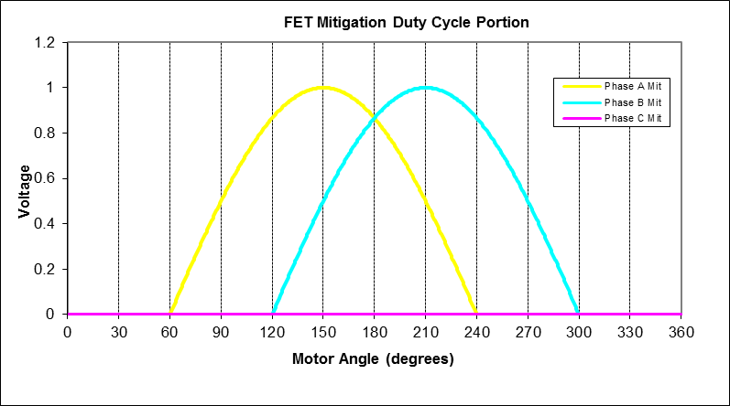
Lower Phase C MOSFET Short Failure Mitigation Line to Neutral Voltage (Phase Adv = 0)

Slide 18
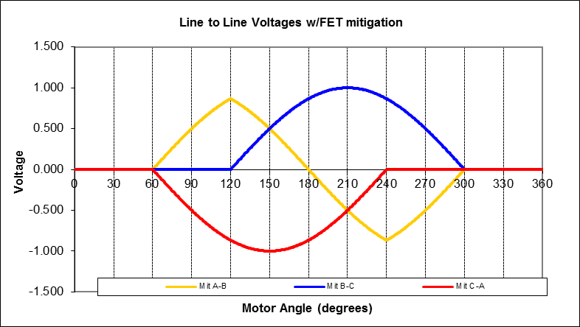
Lower Phase C MOSFET Short Failure Mitigation Line to Line Voltage (Phase Adv = 0)

Slide 19
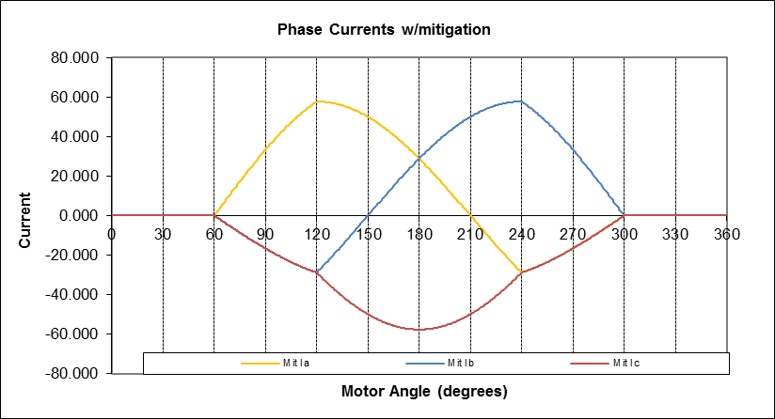
Lower Phase C MOSFET Short Failure Mitigation Phase Currents (Phase Adv = 0)

Slide 20
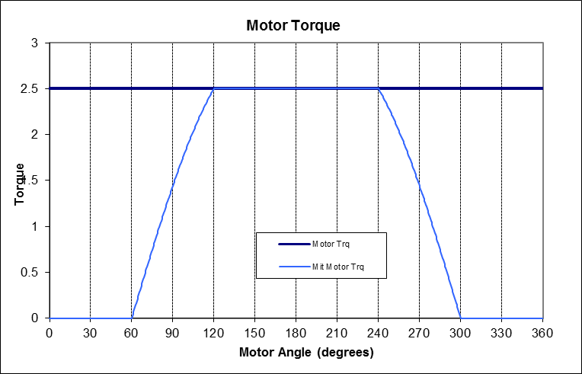
Lower Phase C MOSFET Short Failure Mitigation Torque at Motor Velocity = 0

Slide 21
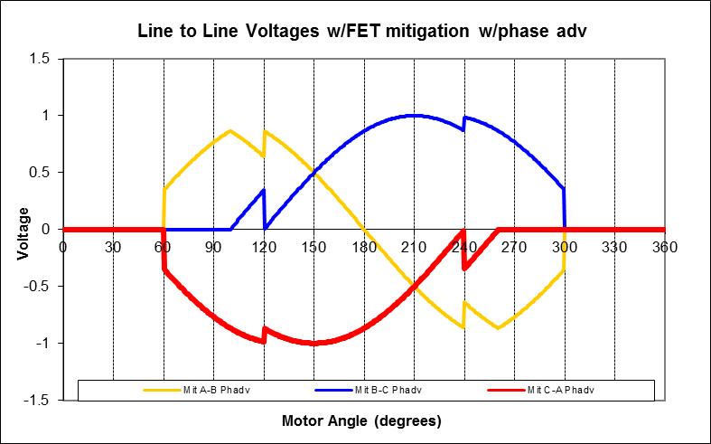
Lower Phase C MOSFET Short Failure Mitigation with Boost Line to Line Voltage (Phase Adv shift = -20, 20)

Slide 22
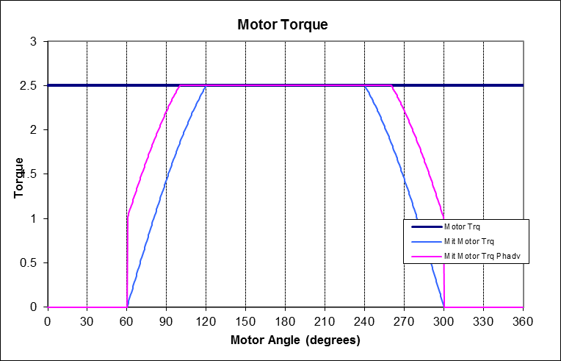
Lower Phase C MOSFET Short Failure Mitigation and Offset Boost: Torque at Motor Velocity = 0

Slide 23
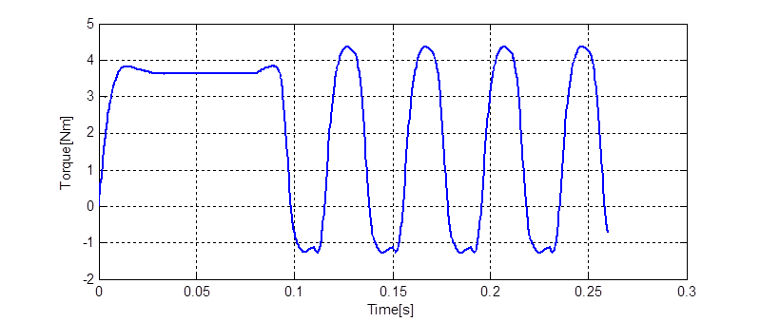
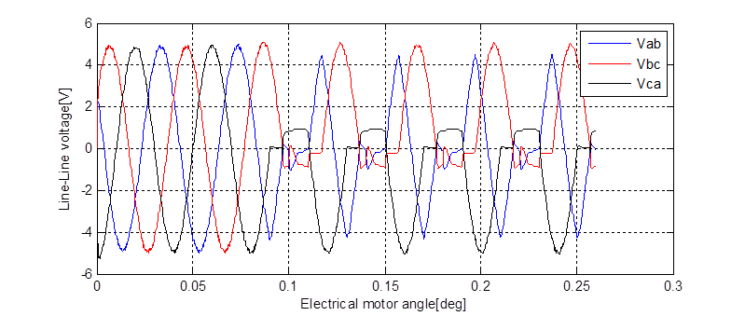
Torque Output with Velocity During the Failure Mitigation Commutation (500RPM)

Slide 24
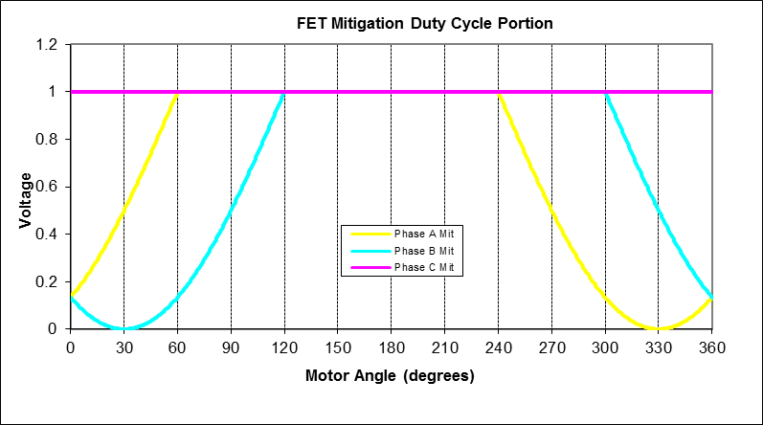
Upper Phase C MOSFET Short Failure Mitigation Line to Neutral Voltage (Phase Adv = 0)

Slide 25
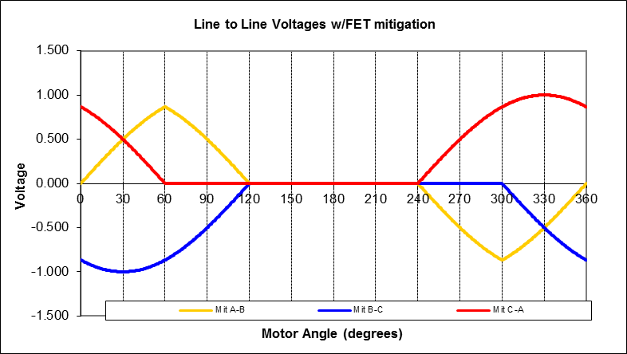
Upper Phase C MOSFET Short Failure Mitigation Line to Line Voltage (Phase Adv = 0)

Slide 26
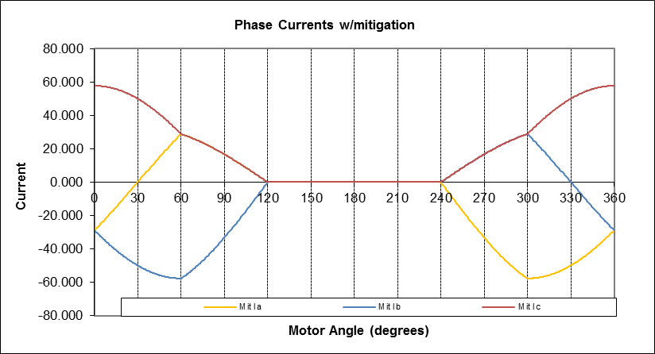
Upper Phase C MOSFET Short Failure Mitigation Phase Currents (Phase Adv = 0)

Slide 27
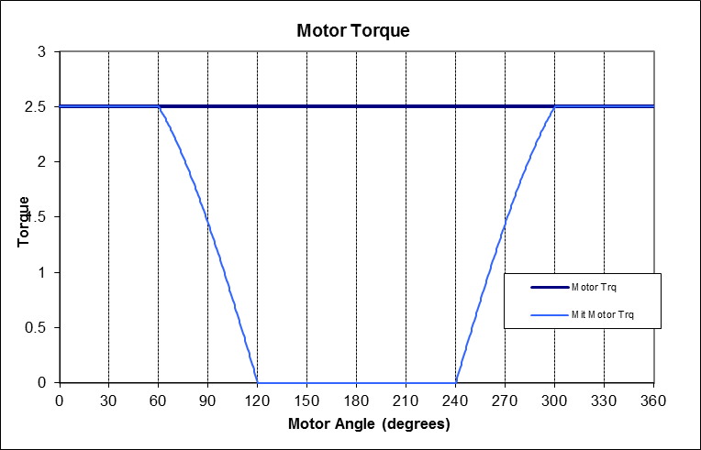
Upper Phase C MOSFET Short Failure Mitigation Torque at Motor Velocity = 0

Slide 28
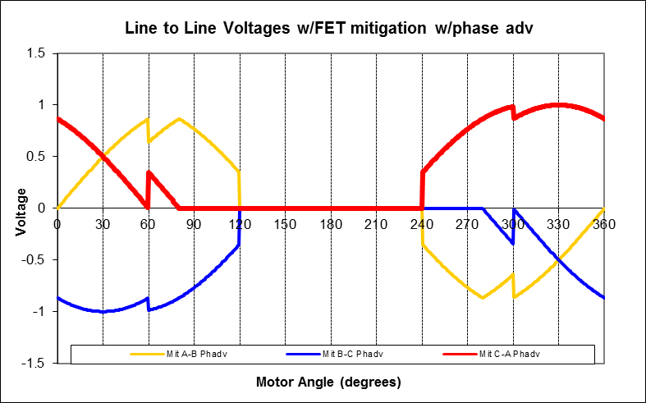
Upper Phase C MOSFET Short Failure Mitigation with Boost Line to Line Voltage (Phase Adv shift = -20, 20)

Slide 29
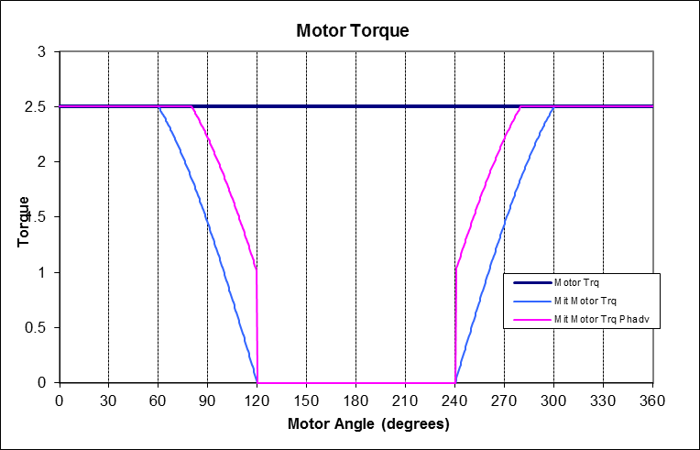
Upper Phase C MOSFET Short Failure Mitigation and Offset Boost: Torque at Motor Velocity = 0

Slide 30
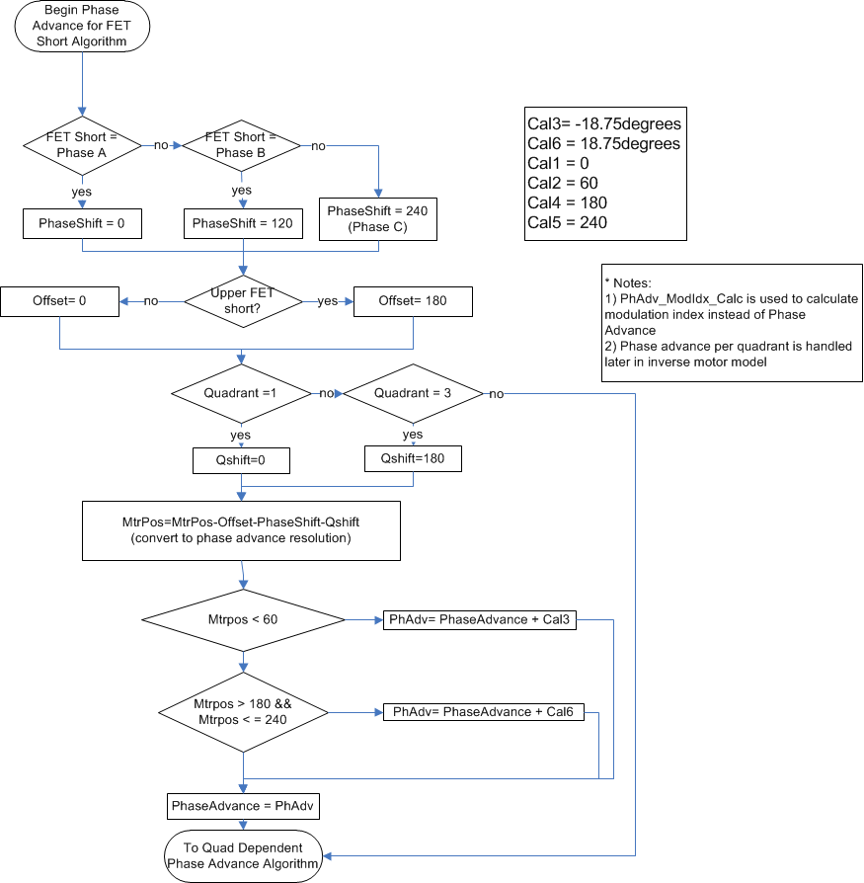
FET Fault Mitigation Algorithm (1 of 2)

Slide 31
FET Fault Mitigation Algorithm (1 of 2)

Slide 32
Open MOSFET with Same Strategy
Currently, the Allegro gate drive cannot distinguish a shorted MOSFET failure from an open MOSFET. An open MOSFET is diagnosed by the Gate Drive IC using the same mechanism that identifies a shorted MOSFET.
When an open MOSFET is diagnosed, the MOSFET mitigation strategy is implemented with its phase complement MOSFET treated as if it were a shorted MOSFET.
The resulting output torque will be similar to the shorted MOSFET condition but without the negative torque generated during the off periods of commutation.
Torque ripple is vastly improved over a shorted MOSFET condition

Slide 33
History of MOSFET Failure Mitigation
Original idea developed and patented by Dr. Sayeed Mir and Future Engineering in 2007
Issues were encountered in the application of the idea into production
Original initiated shorts were incorrectly simulated (x10 resistance)
Original method for reducing ripple resulted in poor thermal performance
Different test result interpretations for lane deviation requirement test
Changes were made and improvement was seen and measured, however ripple due to braking torque was perceived poorly
Used in Production on Gen2+ Voltage Mode Systems
Decision was made not to pursue MOSFET fault mitigation on EA3
In 2014 Future Engineering implemented FET fault mitigation on EA3 to revisit if any improvements could be made
Program target became PSA 1V5 due to the packaging space that did not allow for phase disconnect MOSFET’s
In January of 2015 PSA was shown the enhanced MOSFET fault failure strategy. Nexteer successfully showed compliance to PSA effort level test
Production implementation for enhanced algorithm is anticipated for the PSA 1V5 program

Slide 34
EA3 Implementation Issues for MOSFET Failure Mitigation
Current EA3 software does not report the failed MOSFET correctly.
Gate drive is the same as GEN2+. Must be software issue.
Lower C fault was initiated for simulation and evaluation of fault so issue was not corrected in test code
Non-linearities with EA3 architecture (EPWM) implementation of PWM duty control and dead time when approaching 100% duty cycles
When the product of modulation index and the phase grounding look up table produces 100% duty cycles the first PWM produces a “miss” and turns on the low side complimentary FET for 1 PWM cycle. Since the phase grounding table hits its peak 6 times per electrical cycle this will order track the motor velocity. This error will occur 18 times per motor revolution.
The implementation of dead time produces a dead time on the rising edge of the FET drive. When the duty cycle gets above 100% -dead time the dead time of the upper FET does NOT decrease as the time approaches the end of the PWM cycle. The result is that no increase in voltage is seen between 100% - dead time and 100% duty. This will cause an inherent dead spot during the dead time period.

Slide 35
EA3 Implementation Issues for MOSFET Failure Mitigation (continued)
Non-linearities with EA3 architecture (EPWM) implementation of PWM duty control and dead time when approaching 100% duty cycles (continued)
At 100% duty cycle the top off charge pump used by the gate drive produces enough charge to keep the Upper FET enhanced. No bootstrapping is needed to hold the Upper FET on. This is great but produces an inherent issue… because the dead time on the upper FET will always be fully asserted even 1 count under 100%. This means that full bootstrapping is needed at 100% - 1 PWM count. I measured the bootstrapping on my controller at roughly 10 microseconds every 400 microseconds. This means we lose 2.5% of our voltage just to keep the upper FET enhanced. At 100% we go to full voltage. This will cause a significant jump in voltage.
Similar to previous issue, the bootstrapping will not be needed as much as the lower FET starts to become enhanced after duty cycles lower than 100% - dead time. This bootstrapping time depends on several factors: gate charge, bootstrap cap value, charge pump sizing, lower FET commanded ON time. The bootstrapping will become less and less as the lower FET is enhanced longer. However, any bootstrapping produces errors in voltage. This period will cause another non-linearity.

Slide 36
Enhanced MOSFET Failure Strategy
Utilizes MOSFET Fault Mitigation as base strategy with additional functions to improve driver feel
Several modifications to code were implemented and evaluated
Modulation Index Boost during mitigation
Mitigation enabled/disabled as a function of HW torque
Damping as a function of Filtered Motor Velocity
Several other things were tried and found to have little benefit or undesirable effects and will not be discussed

Slide 37
Modulation Index Boost During Mitigation
Modulation index boost was implemented as a function of vehicle speed (x-axis variable)
A scaling factor was applied to modulation index as the y-axis calibration
Table was 32 point table and was interpolated between points
Scaling factor was limited to 1.5
Column assist did not produce a significant improvement, however, an improvement was noticed in REPS
Thermal analysis must be completed if using this function

Slide 38
Mitigation Enabled/ Disabled as a Function of HW Torque
Hand wheel torques below a certain threshold (around 7Nm) were found to feel better if the system was in manual mode with a FET short.
Below the threshold level the braking torque due to the shorted FET is much lower due to the velocities being lower.
As velocities increase the braking torque increases which effectively produces hand wheel torque over the threshold enabling the FET mitigation.
In this case the “enhancement” was turning it off

Slide 39
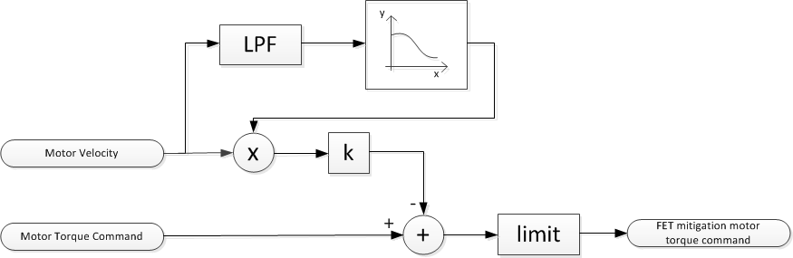
Damping as a Function of Filtered Motor Velocity

Slide 40
Damping as a Function of Filtered Motor Velocity (Continued)
Reduces the motor torque as a function of the filtered motor velocity
Lowers the effective impact of the braking torque because braking torque is a function of back EMF, which is a function of motor speed
Damping constant can be incorporated as a function of vehicle speed if desired. Final tuning produced the same calibrations at all speeds for a column assist system.
Tuning is somewhat subjective since a trade off exist between good feel and increased average torque

Slide 41
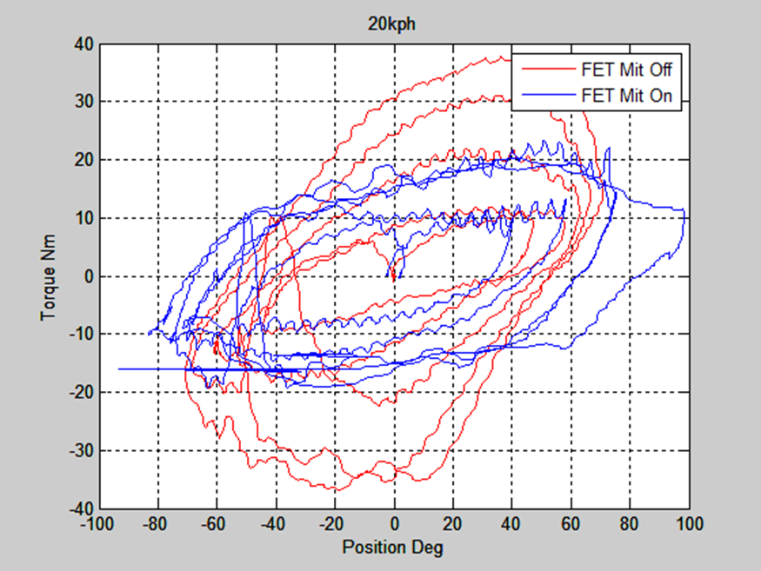
Opel Corsa Data, Sine Sweep Manuevers, Enhanced FET Fault Mitigation On and Off

Slide 42
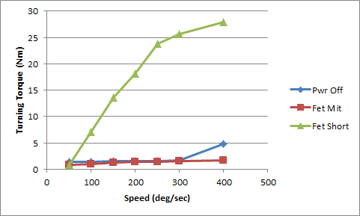
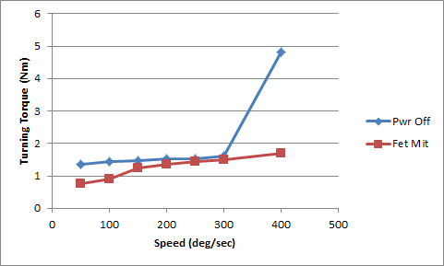
Column Assist Turning Torque Test: FET Short, Manual, and Enhanced FET Fault Mitigation

Slide 43
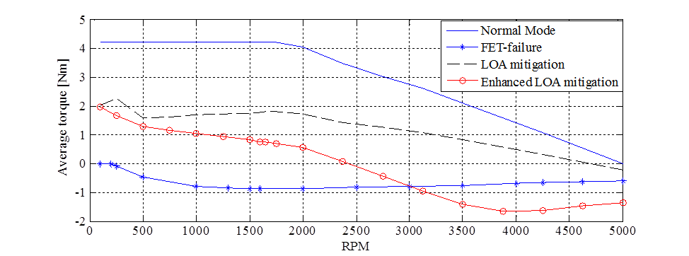
Average Torque with Enhanced FET Fault Mitigation

Slide 44
In Summary
Enhanced FET Fault Mitigation improves the abrupt ripple back to the driver due to the braking torque of the shorted FET
The majority of the benefit is due to damping of the torque command from filtered motor velocity
Several people drove an Opel Corsa with faults injected and approved of the improvements with the LOA mitigation of the MOSFET failure modes
All enhancements are software related with relatively few changes.
Current EA3 architecture needs improvements in FET fault handling and may need modifications for upper FET fault commutation due to 100% duty cycle implementation

